Slide 1

CELL DIVISION AND MITOSIS
Course: BIO 101: Introduction to Biology
Chapter: 8

Slide 2
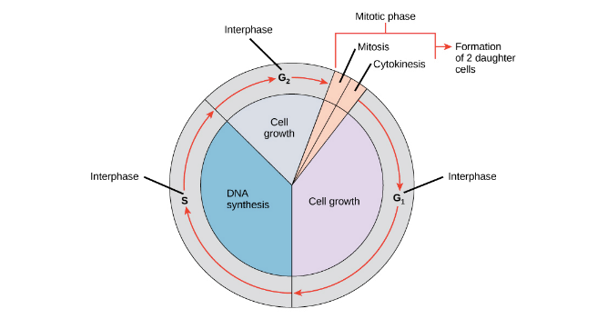
CELL CYCLE
The cell cycle is an ordered series of events involving cell growth and cell division that produces two new daughter cells.
CELL DIVISION
Cell division is the process by which a parent cell divides into two or more daughter cells. Cell division usually occurs as part of a larger cell cycle.

Slide 3
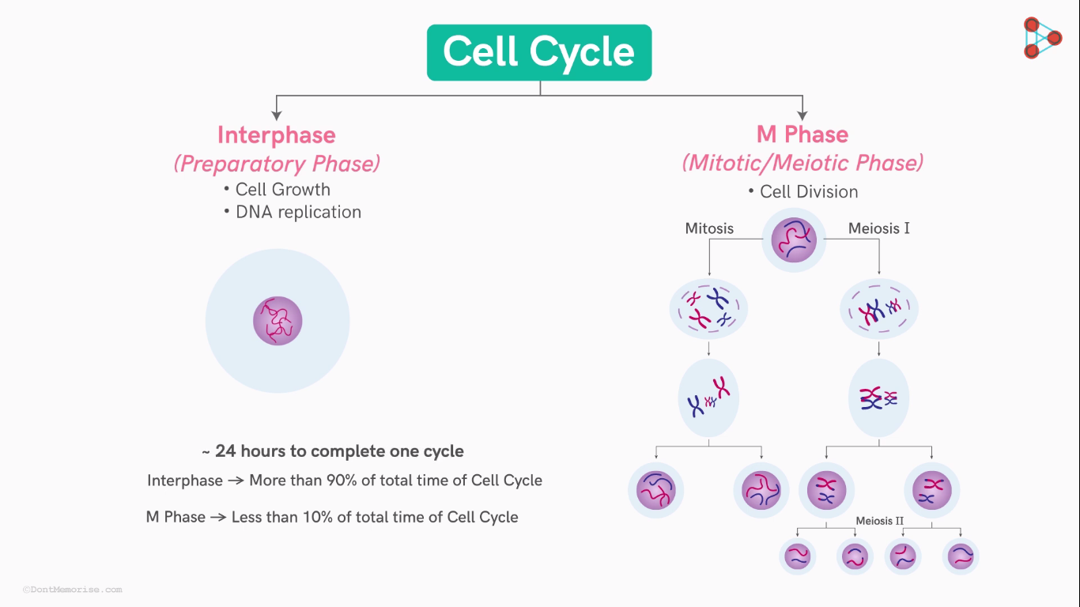
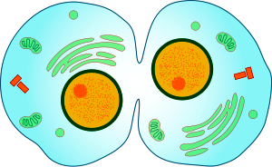

Slide 4
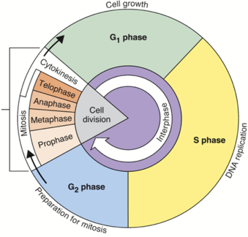
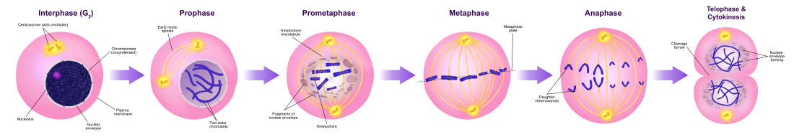

Slide 5
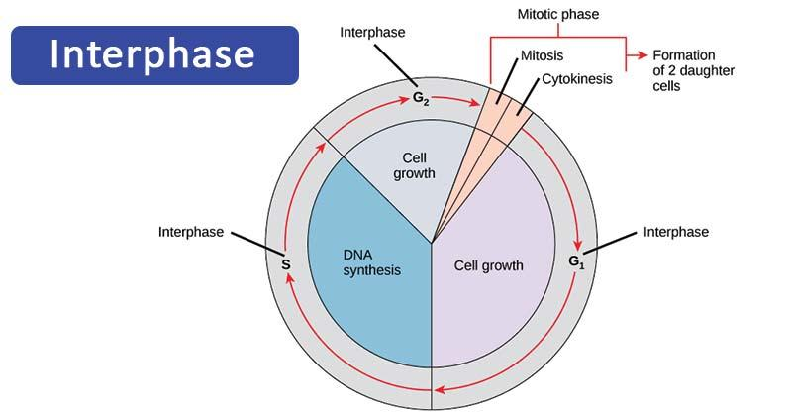
Usually longest part of the cycle
Cell increases in mass
Number of cytoplasmic components doubles
DNA is duplicated

Slide 6
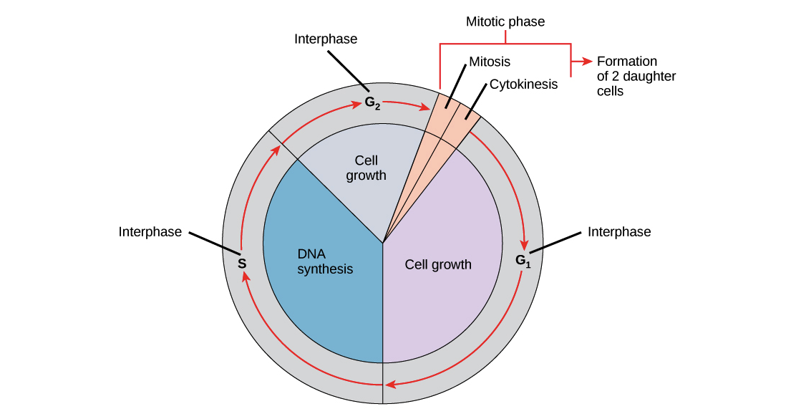
STAGES OF INTERPHASE
G1
Interval or gap after cell division
S
Time of DNA synthesis (replication)
G2
Interval or gap after DNA replication

Slide 7
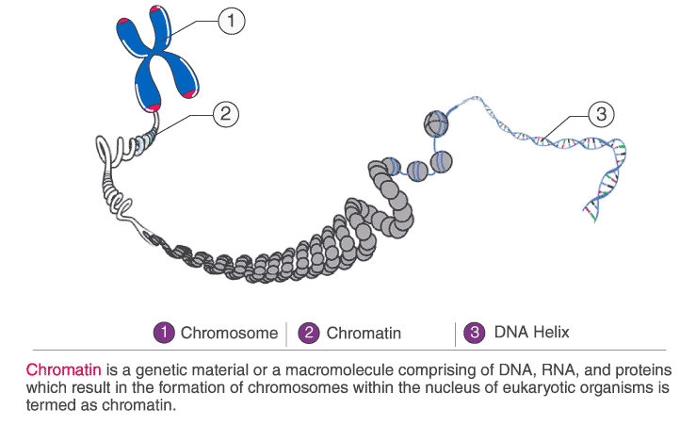
Organization of Chromosomes
Chromosome
Chromatin
DNA
‹#›

Slide 8
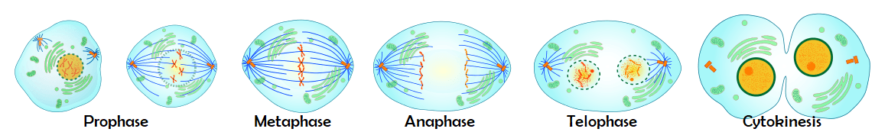
MITOSIS CELL DIVISION
Period of nuclear division
Usually followed by cytoplasmic division
Four stages
Prophase
Metaphase
Anaphase
Telophase

Slide 9
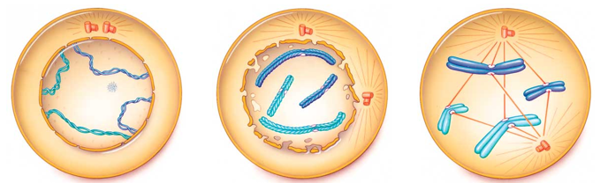
PROPHASE
Duplicated chromosomes begin to condense
New microtubules are assembled
One centriole pair is moved toward opposite pole of spindle
Nuclear envelope starts to break up
Spindle forms
Spindle microtubules become attached to the two sister chromatids of each chromosome

Slide 10
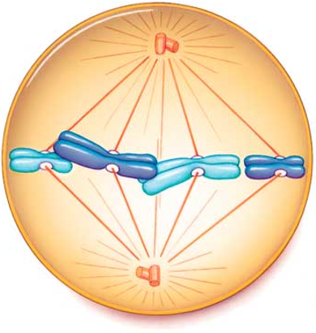
METAPHASE
All chromosomes are lined up at the spindle equator
Chromosomes are maximally condensed

Slide 11
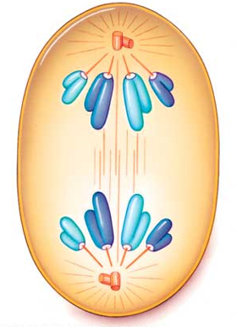
ANAPHASE
Sister chromatids of each chromosome are pulled apart
Once separated, each chromatid is a chromosome

Slide 12
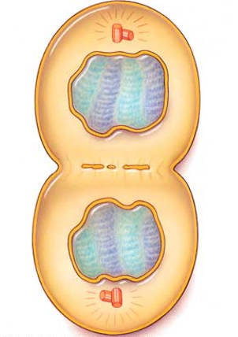
TELOPHASE
Chromosomes de-condense
Two nuclear membranes form, one around each set of unduplicated chromosomes

Slide 13
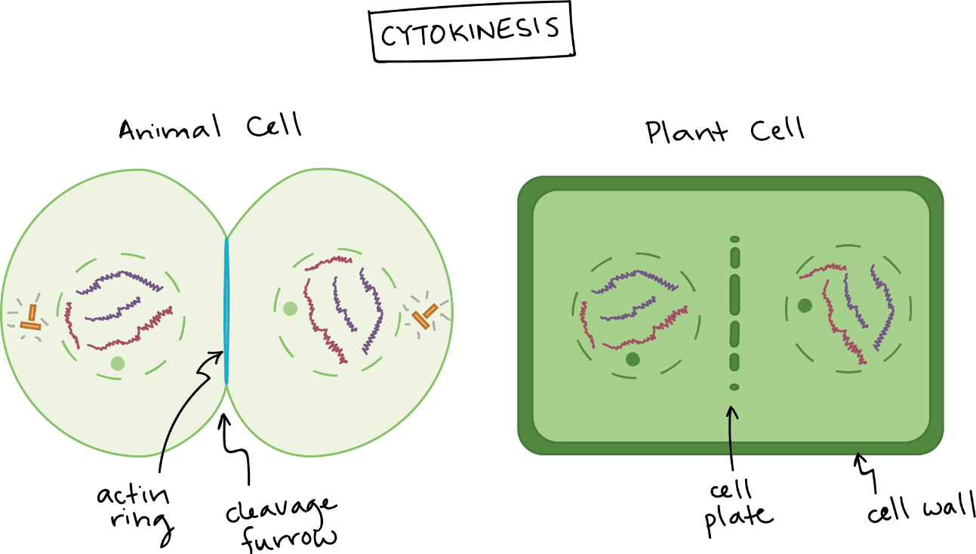
CYTOKINESIS
Cytoplasmic Division
Usually occurs between late anaphase and end of telophase
Two mechanisms
Cleavage (animals)
Cell plate formation (plants)

Slide 14
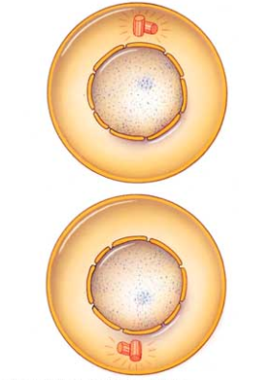
RESULTS OF MITOSIS
Two daughter nuclei
Each with same chromosome number as parent cell
Chromosomes in unduplicated form

Slide 15
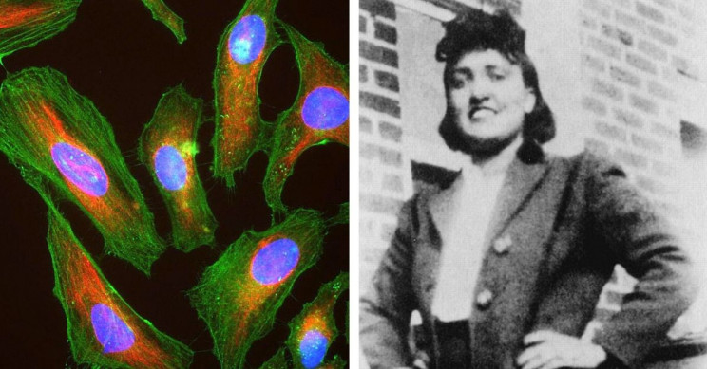
HELA CELLS
Growing cells in culture allows researchers to investigate processes and test treatments without danger to patients
Most cells cannot be grown in culture
Line of human cancer cells that can be grown in culture
Descendants of tumor cells from a woman named Henrietta Lacks
Lacks died at 31, but her cells continue to live and divide in labs around the world

